Slide 1
Dahua SMB Solution
Over Speed Detection
2024.V1

Slide 2
01
02
03
04
05
Challenges
Solution Benefits
Topology & Advantages
Product List
Successful Cases

Slide 3


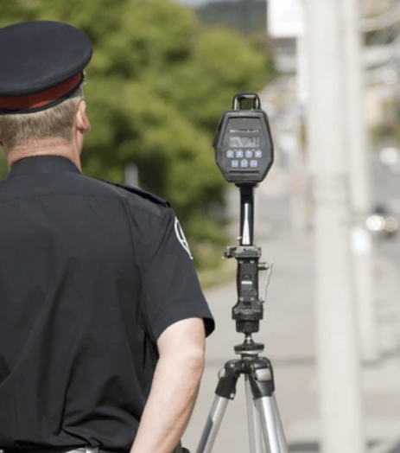
Challenges in Speeding Detection
Overspeeding in gated areas such as industrial parks and school campuses can result in casualties and property damages. Despite intensified efforts, various challenges still remain in regulating driver behavior and collecting adequate evidence for law enforcement.
1
1
3
2
3
2
Casualty & property damage
Fast vehicles in gated areas can cause severe property damages and accidents.
Ineffective warning sign
Traditional signage is not effective in alerting drivers and regulating their driving behavior.
Lack of adequate evidence
The lack of sufficient evidence after an incident makes it difficult to conduct thorough investigations.

Slide 4

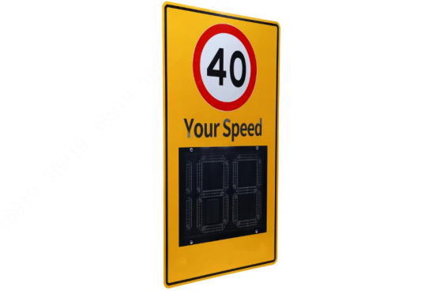
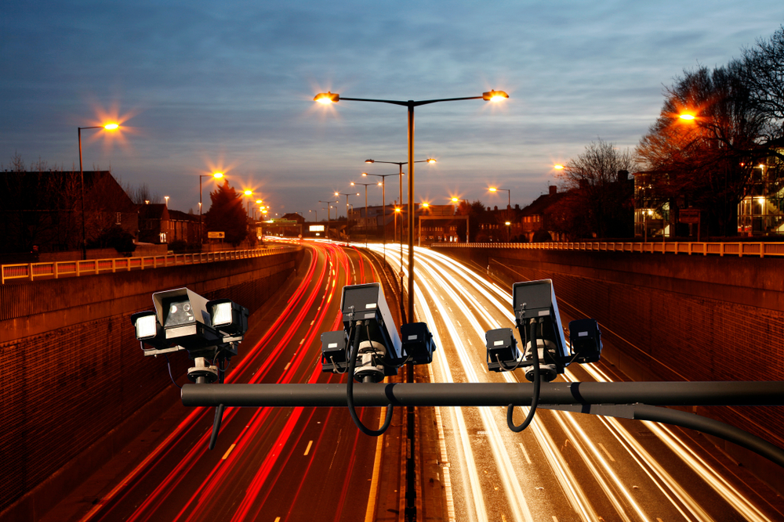
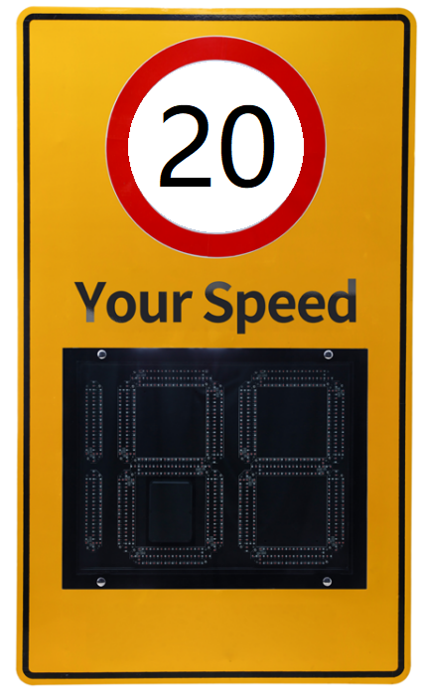
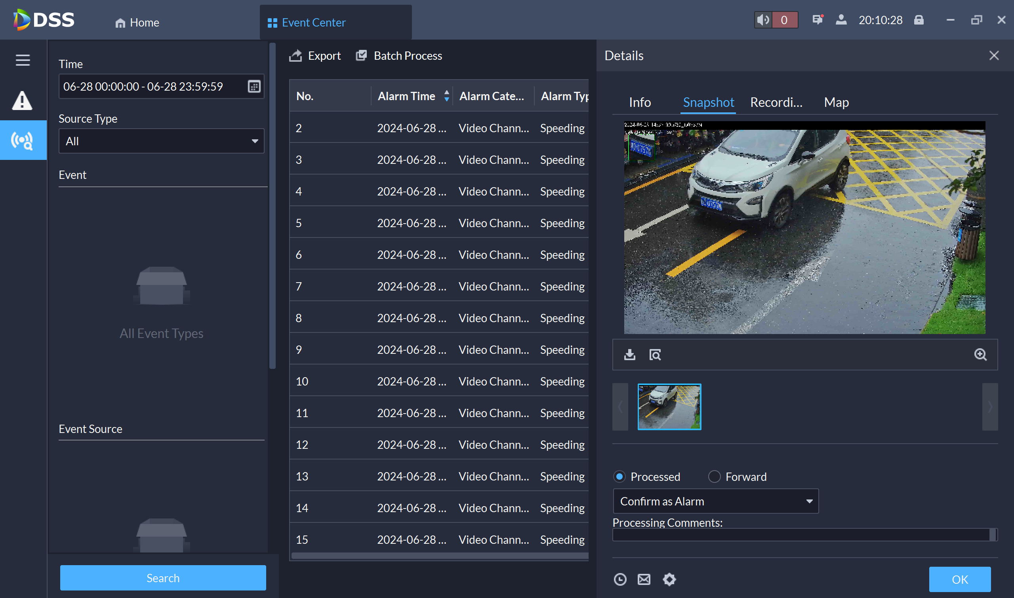
Benefits of Over Speed Detection Solution
The Dahua Over Speed Detection Solution provides 24/7 real-time speed measurement and display, efficiently regulating drivers to ensure safe driving. Fused with AI ANPR technology, it makes vehicle records easy to retrieve through detailed vehicle attributes, significantly improving enforcement.
24/7 Speed Monitoring and Detection System
Real-time Speed Display with Audio Alerts
Streamlined Video Evidence Retrieval
The 24/7 high-precision all-weather vehicle speed monitoring system enhances safety by ensuring continuous monitoring, accurate data collection and reduced response time.
Real-time speed display with audio alerts enhances safety by providing immediate feedback, increasing driver awareness, and promoting compliance with speed limits.
Streamlined video evidence retrieval improves time efficiency, information accuracy, and case management for law enforcement.

Slide 5
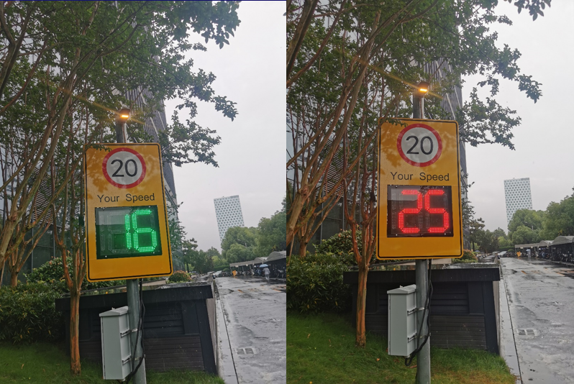

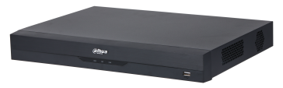

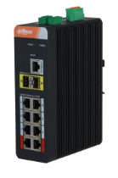
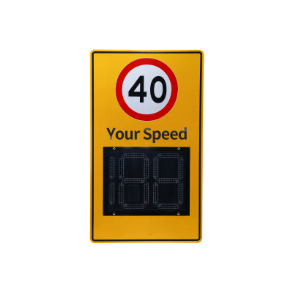
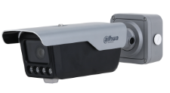

Solution Topology & Advantages
Topology
Advantages
Accurate and clear
High precise radar with deviation of -4 to 0 km/h
Self-developed plate recognition algorithm, with capture rate＞99%, recognition accuracy＞98%
Clear indication of driving speed by red color for over speed and green color for normal speed
DSS Express
NVR5216-EI
NVR
LM22-B200S
Monitor
Software
Management Center
Switch
Efficient retrieval
Quick retrieval over speed record by vehicle plate and alarm event.
Sufficient evidence with snapshots and video records
ITACS-024SA
Radar Signboard
ITC413-PW4D-Z3
ANPR Camera
Work Flow
All-environment adaptability
IP67 protection rating (dustproof and waterproof), IK10 impact rating, with aluminum alloy body
Can adapt to extreme environments, with a wide range of working temperatures from –30 °C to +65 °C
Adapts to rain, snow, fog, with camera front window’s intelligent heating module
16KM/h
ANPR
16
ANPR
24KM/h
24
24
Please slow down!
Alarm info and record retrieve
Notes:
测速屏和 ITC有一根485线， 车道是单车道, 超速事件搜索，

Slide 6
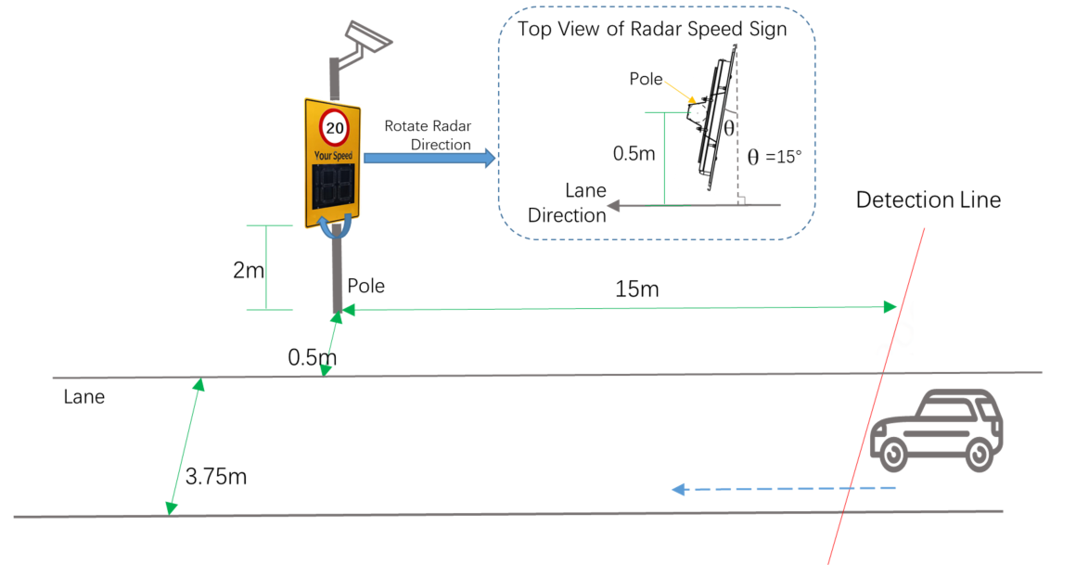
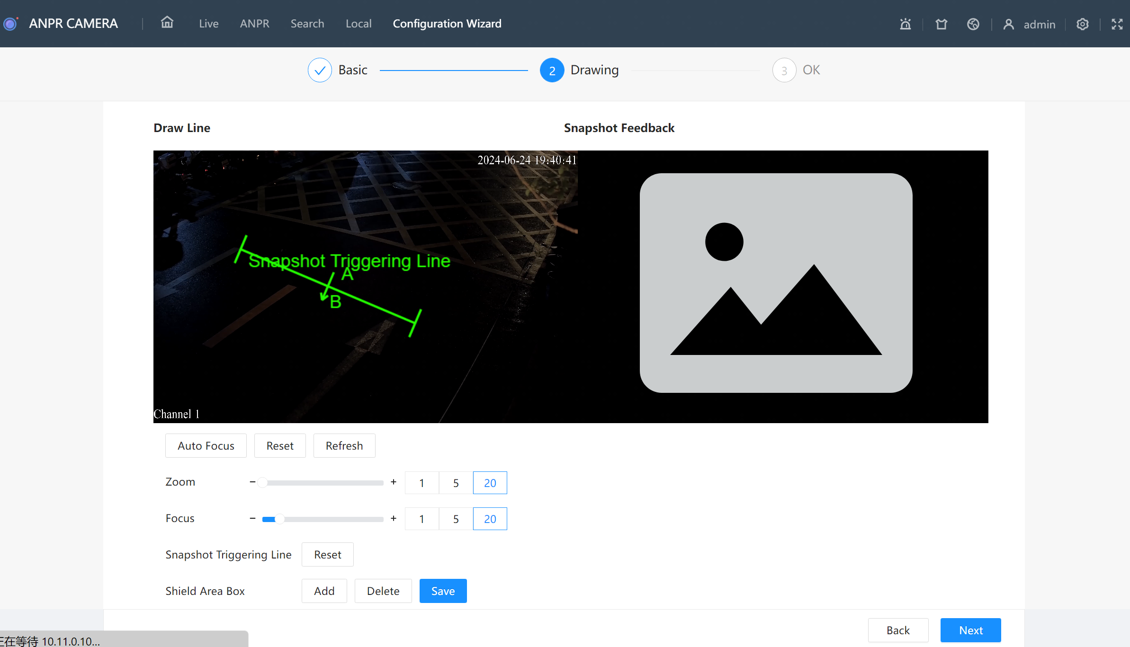
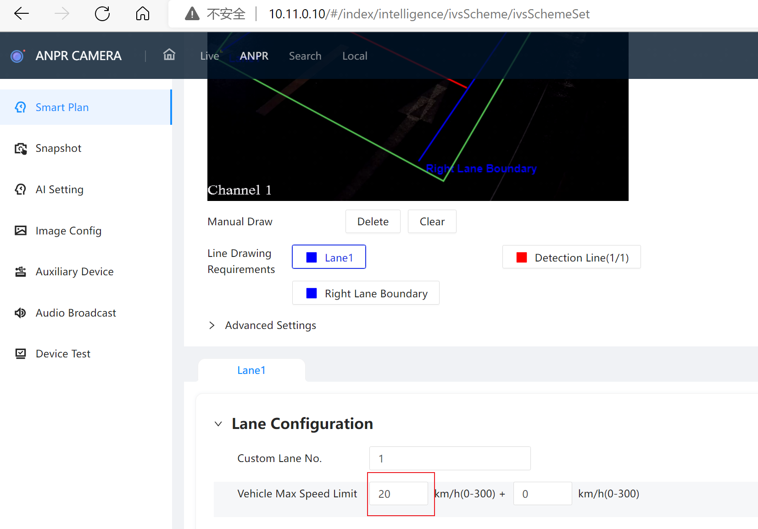
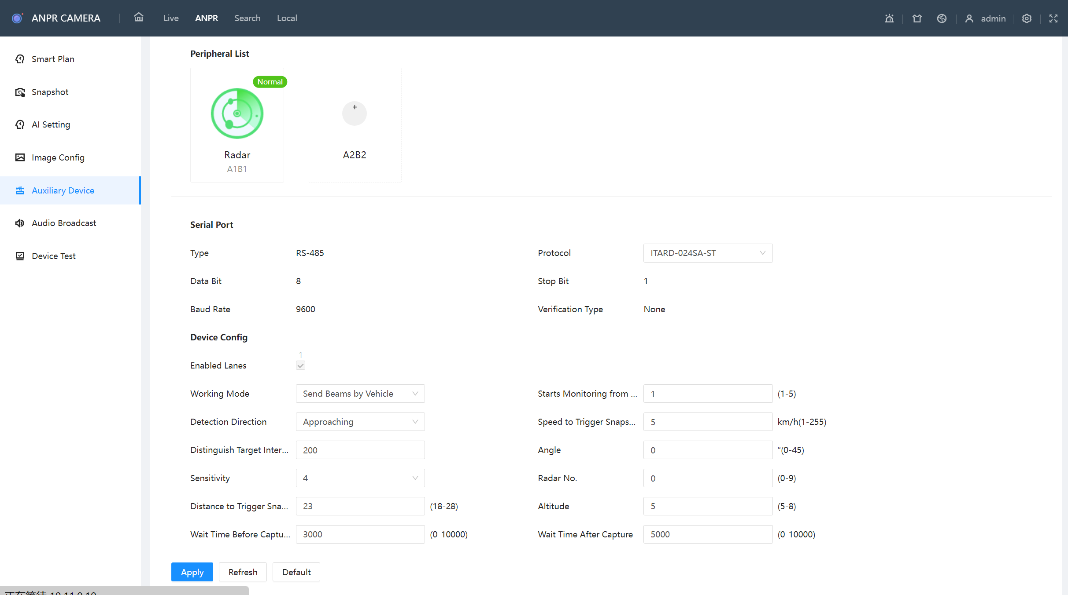
Deployment
Installation
Configuration
Drawing the trigger line
The capture point to the camera distance recommend 15 meters
Speed limit setting
The speed limit setting 20km/h
Installation method: Install the Sign at the right (for regions driving on the right) or left (for regions driving on the left) side of road.
Installation height: About 2 m (6.56 ft), adjustable between 1.5 m (4.92 ft) and 3 m (9.84 ft).
Radar installation angle: θ = 15°. θ is the angle between the radar normal line and the road horizontal line. The angle can be adjusted.
Camera installation height 3.5m, adjust it angle to make sure the detection line which is around the middle of the image is 15m away from the pole.
Radar Parameter setting
Radar working mode Send continuous beams
Angle 15
Notes:
485 线 接线， Customer event 配置补充一下， DSS express 事件联动，存储位置的设置。

Slide 7
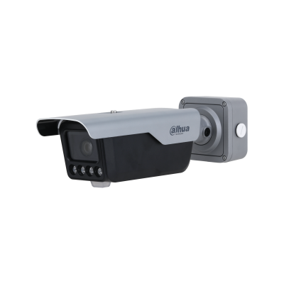
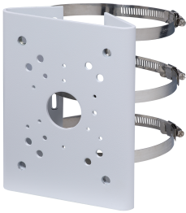
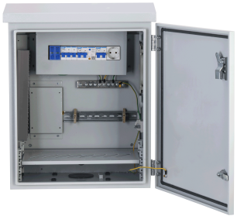
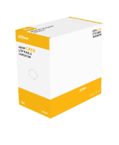
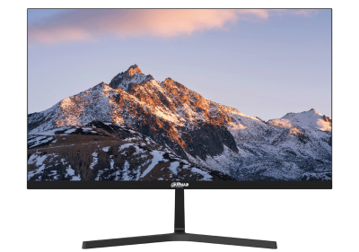
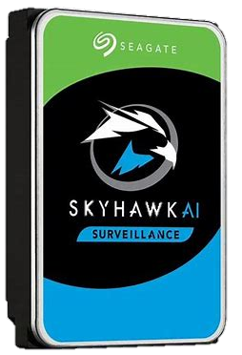

Product List
Category | Model | Description | Image
ANPR camera | ITC413-PW4D-Z3 With Special Firmware | 4MP ANPR camera with customized firmware compatible with speed detect radar
Bracket | PFA150 | ANPR Camera Installation Bracket
Speed Radar | ITACS-024SA-JB | High accuracy speed detection radar
Sign Board | ITACS-024SA-JA20 | Speed sign board with 20Km/h mark
Distributio Box | PFC102F | Distribution box
Transmission | DH-IS4210-8GT-120 | 10-Port Managed Industrial Gigabit Switch with 8-Port
 | DH-PFM920-6U | 305m Outdoor UTP CAT6 Cable (Black)
Control Center | NVR5216-EI | Storage
 | LM22-B200S | 21.5 inches monitor
 | ST2000VX016 | 2TB/5400RPM/256M/ SATA 6Gb/s /Seagate Standard SkyHawk
 | DSS Express V8.4 | DSS Express V8.4
Notes:
1.

